Slide 1
Project Scheduling
Punjab University College of Information Technology

Slide 2
What is project scheduling
Proper scheduling requires that
  All tasks appear in the network
  Effort and timing are intelligently allocated to each task
  Interdependencies between tasks are properly indicated
  Resources are allocated for the work to be done
  Closely spaced milestones are provided so that progress can be tracked

Slide 3
Project Planning Basics
As a project manager, your objective is
  Define all project tasks
  Build a network that depicts their interdependencies
  Identify the tasks that are critical within the network
  And then track their progress to ensure that delay is recognized “one day at a time”

Slide 4
Project Scheduling
Interdependencies among tasks may be defined using
  Task network also called project work breakdown structure
  Time-line chart also called Gantt Chart

Slide 5
1. Task Network – Activity Network
A graphic representation of task flow for a project
Leads to a number of important scheduling requirements
  Parallel tasks occur asynchronously
  Intertask dependencies
  Tasks on the critical path

Slide 6
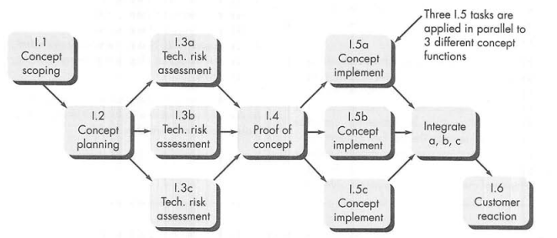
1. Task Network – Activity Network

Slide 7
1. A task set example
Concept development project – to explore new business concept or application of some new technology
Concepts development actions
  Concept scoping
  Preliminary concept planning
  Technology risk assessment
  Proof of concept
  Concept implementation
  Customer reaction

Slide 8
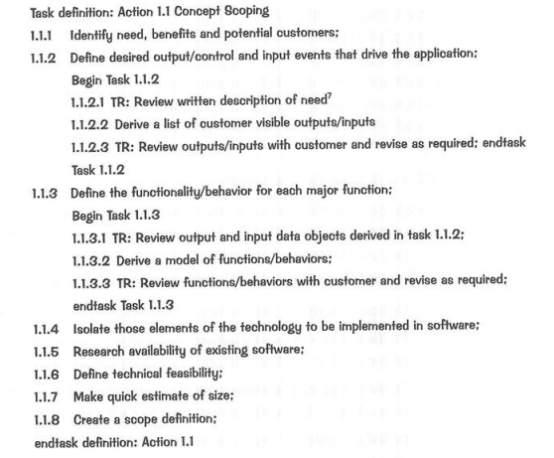
1. SE Actions

Slide 9
1. Task Network – Activity Network

Slide 10
A “work breakdown statement (WBS)” is a categorized list of tasks with an estimate of resources required to complete the task.
WBS # | Task Description | Duration | Resources
5 | User handling
5.1 | Register user | 2 | John
5.2 | Create Login & Verification | 4 | Peter
5.3 | User rights definition | 3 | Fred
5.4 | User control panel | 3 | Biba

Slide 11
2. Time line charts
Also called Gantt Chart
A Gantt chart is a graphical representation of the duration of tasks against the progression of time
Gantt charts are bar graphs that help plan and monitor project development or resource allocation on a horizontal time scale.

Slide 12
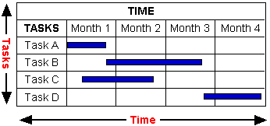
2. Time line charts

Slide 13
2. Time line charts
Gantt Charts are useful tools for planning and scheduling projects
  Gantt charts allow you to assess how long a project should take.
  Gantt charts lay out the order in which tasks need to be carried out.
  Gantt charts help manage the dependencies between tasks.

Slide 14
2. Time line charts
Gantt Charts are useful tools when a project is underway
  Gantt charts monitor progress. You can immediately see what should have been achieved at a point in time
  Gantt charts allow you to see how remedial action may bring the project back on course

Slide 15
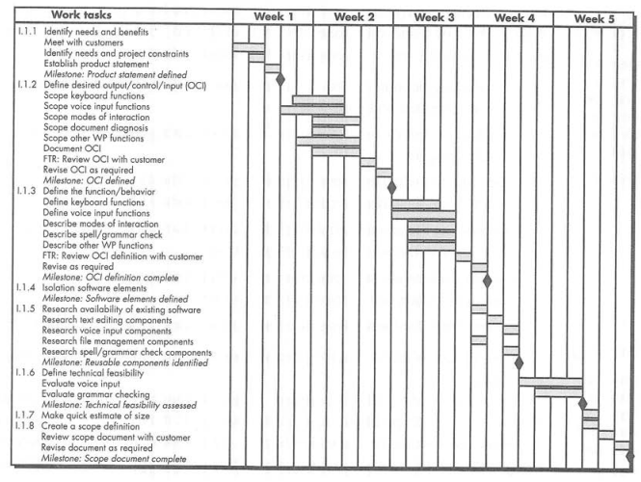
2. Time line charts

Slide 16
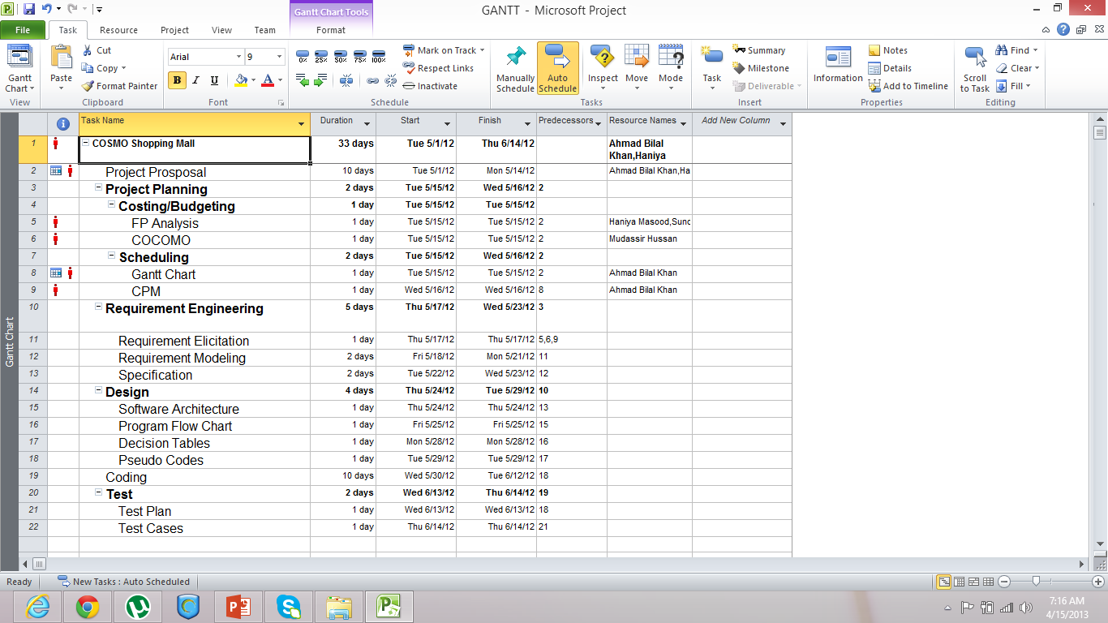

Slide 17
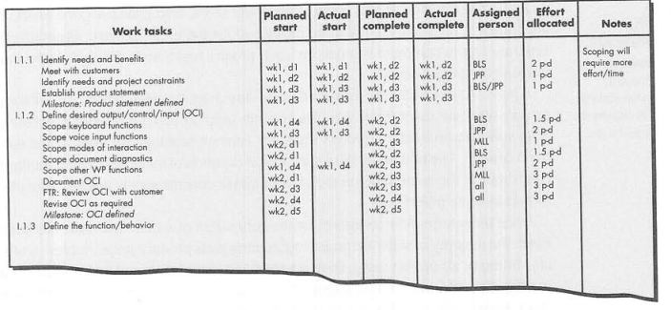
2. Time line charts

Slide 18
Critical Path Method

Slide 19
Critical Path Method
Project activities and their relationships
Used to determine Shortest Path w.r.t. Duration
Total Duration and Slacks counting ( Total Slack & Free Slack)
Good practice to identify activities which critical and which are not critical
Two Techniques (AOA & AON)

Slide 20
Critical Path Method
Rules:
Each node must have at least one successor except to terminal node
Each node must have at least one predecessor except to First node
Only one initial and one terminal node
Arrow only shows precedence, no relationship with duration

Slide 21
Critical Path Method
Attribute to be calculated:
(In Forward Walk, We fix ES=0 for first activity)
ES (K) = max [ EF (J): J is an immediate predecessor of K ]
EF (K) = ES (K) + L (K)
If there are more than one predecessor
ES (K) = max { EF(pred 1), EF (pred 2)}

Slide 22
Critical Path Method
Attribute to be calculated:
(In Backward Walk LF of last activity is set = EF)
LF (K) = min [ LS (J): J is an immediate successor of K ]
LS (K) = LF (K) - L (K)
If there are more than one successor
LF (K) = min { LS(succ. 1), EF (succ. 2)}

Slide 23
Critical Path Method
Slacks:
  TS (K) = LS (K) – ES (K)
  FS (K) = min [ES (J) : J is successor of K] – EF (K)
  Activities having total slack zero will make critical path

Slide 24
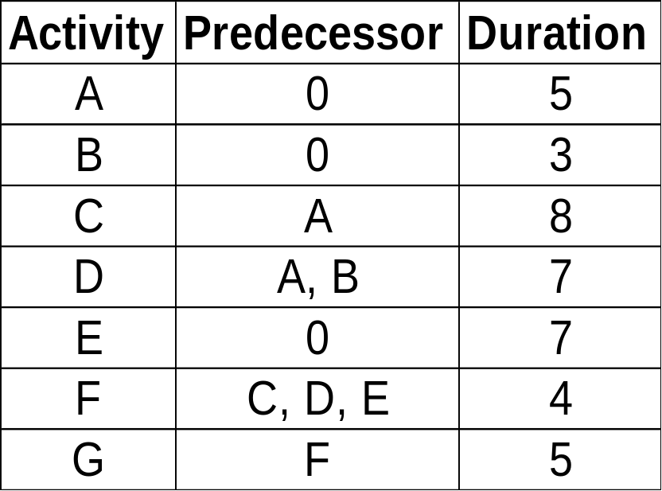
Critical Path Method - Example

Slide 25
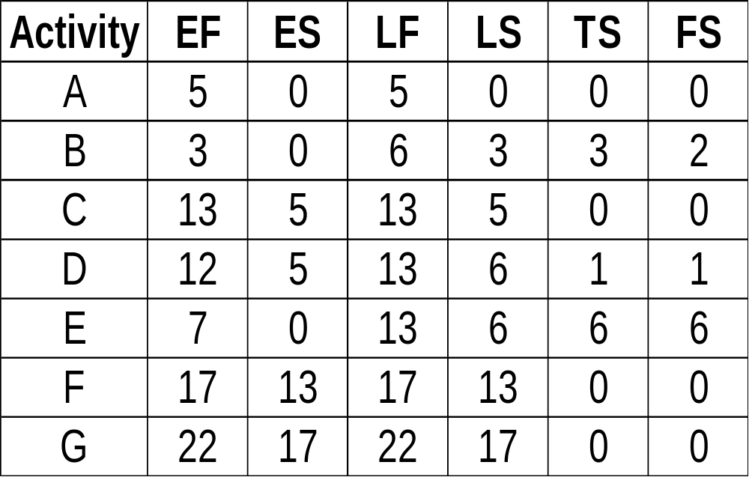
Critical Path Method - Example

